Slide 1
Normality of residuals
By: Dr. Syed Hassan Raza

Slide 2
Why and when it is important to check the normality?
Many researchers believe that multiple regression requires normality. This is not the case. Normality of residuals is only required for valid hypothesis testing, that is, the normality assumption assures that the p-values for the t-tests and F-test will be valid. Normality is not required in order to obtain unbiased estimates of the regression coefficients. OLS regression merely requires that the residuals (errors) be identically and independently distributed. Furthermore, there is no assumption or requirement that the predictor variables be normally distributed. If this were the case than we would not be able to use dummy coded variables in our models.

Slide 3
How do we check the normality?
After we run a regression analysis, we can use the predict command to create residuals and then use commands such as kdensity, qnorm and pnorm to check the normality of the residuals.

Slide 4
Data to check the normality
We will be using a data file that was created by randomly sampling 400 elementary schools from the California Department of Education’s API 2000 dataset. This data file contains a measure of school academic performance as well as other attributes of the elementary schools, such as, class size, enrollment, poverty, etc.
Measure of academic performance of the school (api00), the average class size in kindergarten through 3rd grade (acs_k3), the percentage of students receiving free meals (meals) – which is an indicator of poverty, and the percentage of teachers who have full teaching credentials (full).
Let’s predict academic performance (api00) from percent receiving free meals (meals), percent of English language learners (ell), and percent of teachers with emergency credentials (emer).
use https://stats.idre.ucla.edu/stat/stata/webbooks/reg/elemapi2

Slide 5
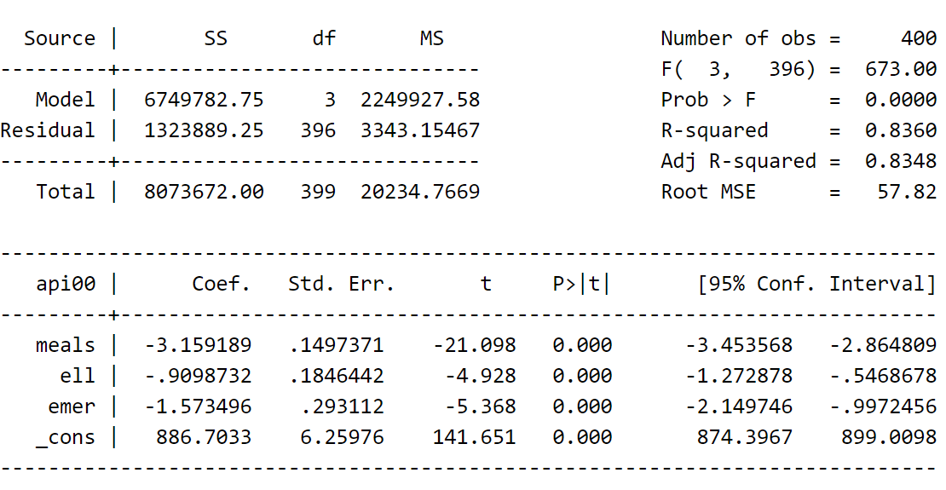
PREDICTING ACADEMIC PERFORMANCE & Generating residuals
regress api00 meals ell emer
predict r, resid

Slide 6
What is kernel density?
Kernel density estimators approximate the density f(x) from observations on x. Histograms do this, too, and the histogram itself is a kind of kernel density estimate. The data are divided into nonoverlapping intervals, and counts are made of the number of data points within each interval. Histograms are bar graphs that depict these frequency counts—the bar is centered at the midpoint of each interval—and its height reflects the average number of data points in the interval.
We use the kdensity command to produce a kernel density plot with the normal option requesting that a normal density be overlaid on the plot. kdensity stands for kernel density estimate. It can be thought of as a histogram with narrow bins and moving average.

Slide 7
kernel density
kdensity r, normal

Slide 8
STANDARDIZED NORMAL PROBABILITY (P-P) & quantiles of a variable against the quantiles of a normal distribution
The pnorm command graphs a standardized normal probability (P-P) plot while qnorm plots the quantiles of a variable against the quantiles of a normal distribution. pnorm is sensitive to non-normality in the middle range of data and qnorm is sensitive to non-normality near the tails. As you see below, the results from pnorm show no indications of non-normality, while the qnorm command shows a slight deviation from normal at the upper tail, as can be seen in the kdensity above. Nevertheless, this seems to be a minor and trivial deviation from normality. We can accept that the residuals are close to a normal distribution.

Slide 9
STANDARDIZED NORMAL PROBABILITY (P-P)
pnorm r

Slide 10
quantiles of a variable against the quantiles of a normal distribution
qnorm r

Slide 11
Numerical test to check normality
iqr stands for inter-quartile range and assumes the symmetry of the distribution. Severe outliers consist of those points that are either 3 inter-quartile-ranges below the first quartile or 3 inter-quartile-ranges above the third quartile. The presence of any severe outliers should be sufficient evidence to reject normality at a 5% significance level. Mild outliers are common in samples of any size. In our case, we don’t have any severe outliers and the distribution seems fairly symmetric. The residuals have an approximately normal distribution.

Slide 12
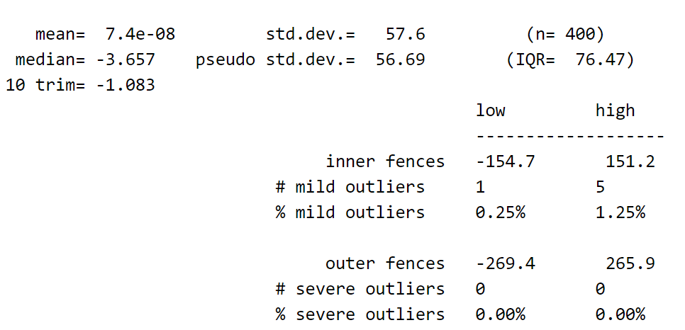
Numerical test to check normality
iqr r

Slide 13
Thank you

